Slide 1
UI Team 01
Presented by
Matthew Bizga
Adam Boudraa
Kenny Lucgau
Ushan Hassan

Slide 2
The Mission
The site will be a platform for the user to showcase their current portfolio along with contact information which will enable them to network other voice actors and directors

Slide 3
Site Objectives
Help to network with other actors
Give casting directors a sort of pseudo-resume
Provide current portfolio of user
Attract casting director can reach out regarding for casting
Provide user’s bio
Provide user’s demo reel

Slide 4
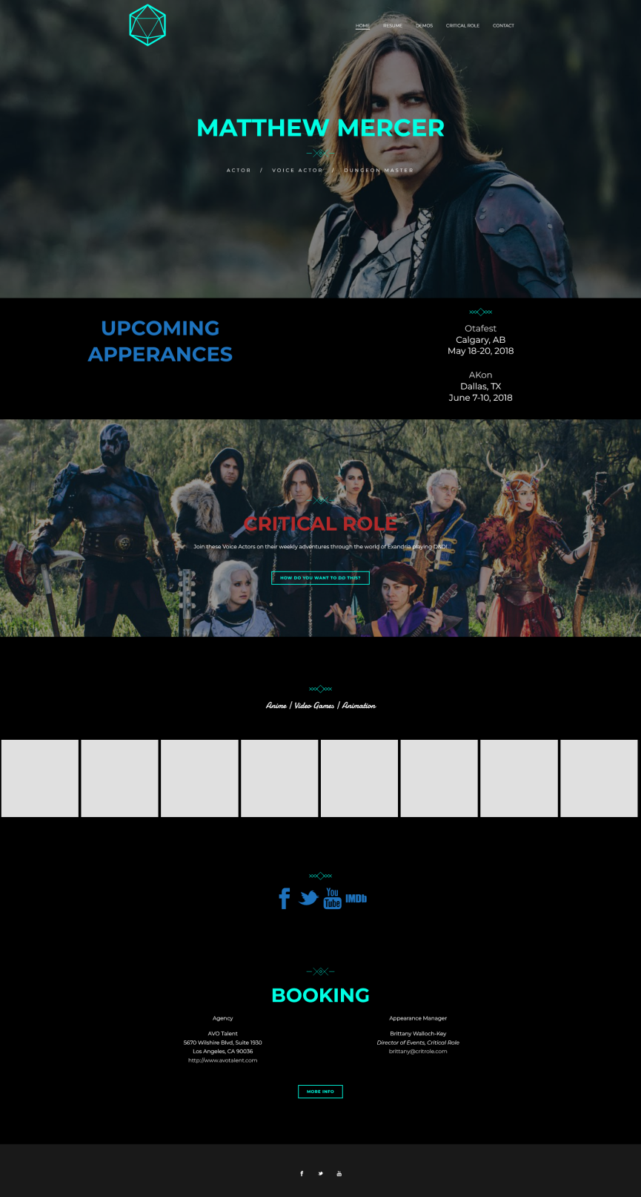
Page to Copy
The client wishes to copy this design.

Slide 5



Example User Profiles
Voice actor: Cherami Leigh
Director: Harold Ramis

Slide 6
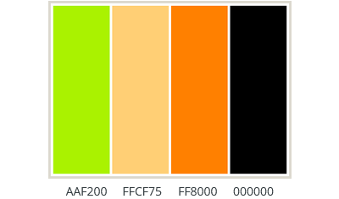
Personality & Palette
Color | Feeling | Use
Black | Professionalism, sophistication & elegance | Background color that does not put stain on the eyes of the user compared to a white background (Miarka, 2019).
Goldenrod | Happiness, playfulness & energizing one | Menus and navigation. Pops off the page.
White | sophistication, cleanness and optimism | Text on the page.

Slide 7
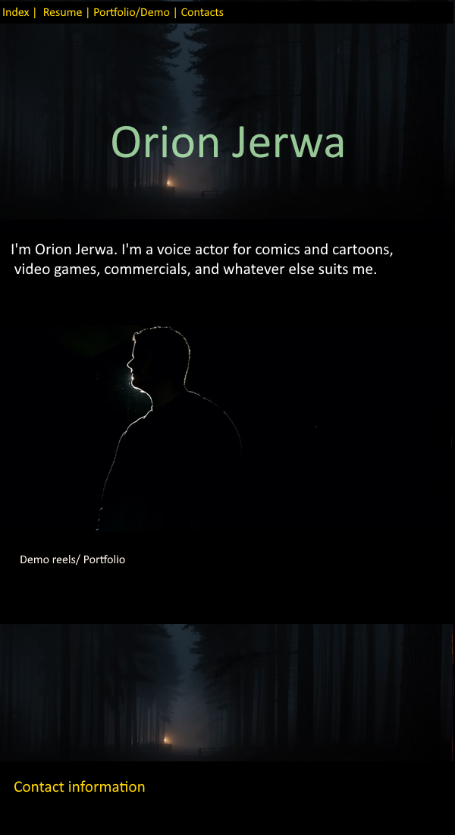
User Page
Movement down the page
“Quick links” on the bottom for contacts
User Anchor Html link to section with fix
top menu bar
Purpose easily noticeable (it’s about actor)
Need to include parallax with multi images
Follows the design that the client, Orion, wanted to copy.

Slide 8
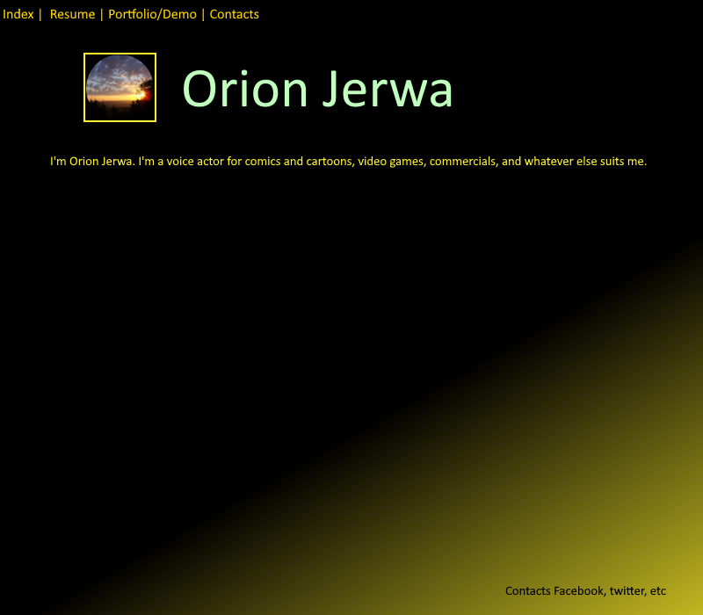
User Page
Movement down the page
“Quick links” on the bottom for contacts
User Anchor Html link to section with fix
top menu bar
Purpose easily noticeable (it’s about actor)
Need to include parallax with multi images

Slide 9
Next Steps
Incorporate student feedback
Obtain sign-off from client and clarification question for further understanding
Work on current issues with style and color consistency.
Restart on production phase for desktop and mobile

Slide 10
Citation
We Love Colors. (2016, September 16). Color psychology – the meaning of the color yellow. We Love Colors. Retrieved February 3, 2023, from https://www.welovecolors.com/buzz/2016/Color-Psychology-%E2%80%93-The-Meaning-of-The-Color-Yellow
Braam, H. van. (2020, September 9). Black Color Psychology - black meaning & personality. Color Psychology. Retrieved February 3, 2023, from https://www.colorpsychology.org/black/
Miarka, P. (2019, January 24). Benefits of dark background on your website. Droptica Blog. Retrieved February 3, 2023, from https://www.droptica.com/blog/benefits-dark-background-your-website/

